Slide 1

CAN
Presented by : Ahmed Yassin
Senior I Electronics and Electrical Communications dep.
Embedded Committee Instructor
2023 / 2024

Slide 2
Controller Area Network (CAN bus)
What is CAN bus?
Why do we need CAN bus?

Slide 3
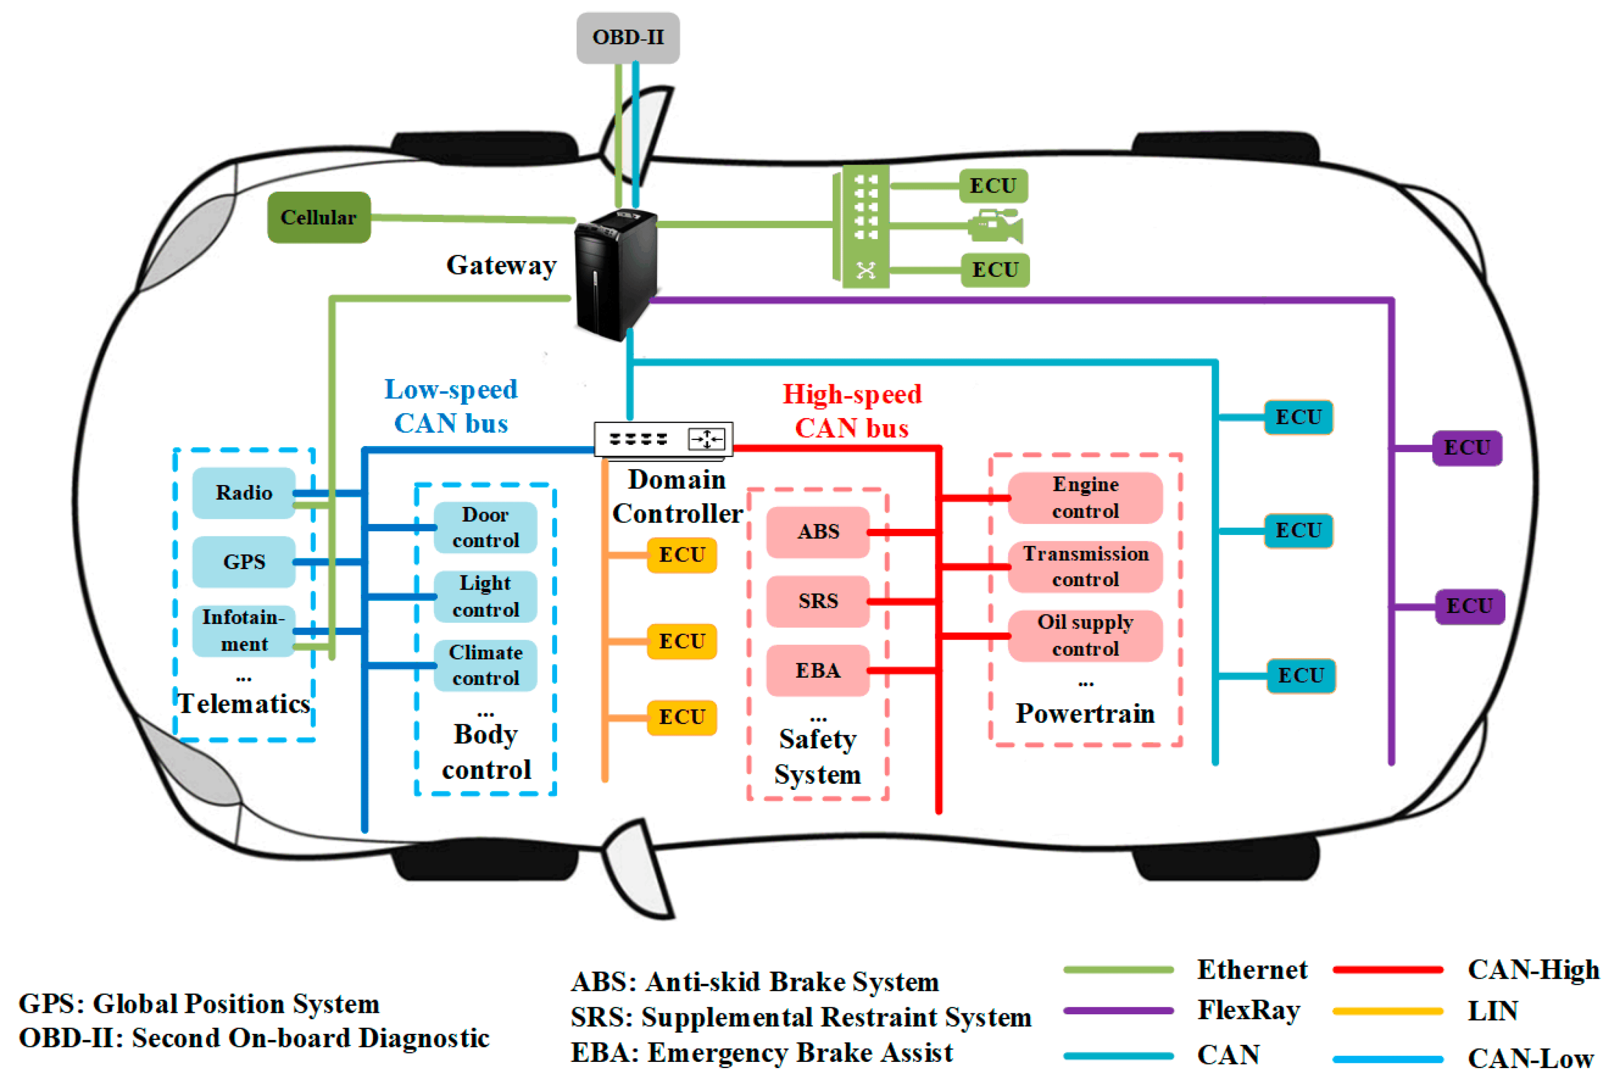
Controller Area Network (CAN bus)
What is CAN bus?
Why do we need CAN bus?

Slide 4
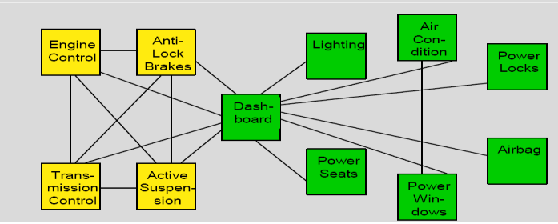
Controller Area Network (CAN bus)
What is CAN bus?
Why do we need CAN bus?

Slide 5
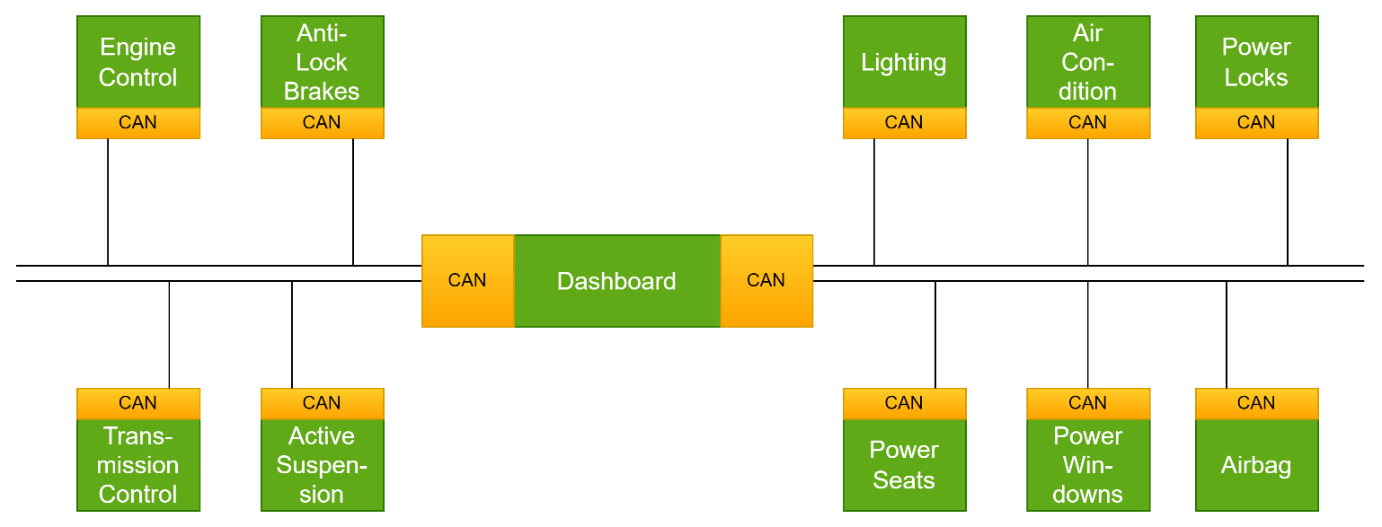
Controller Area Network (CAN bus)
What is CAN bus?
Why do we need CAN bus?

Slide 6
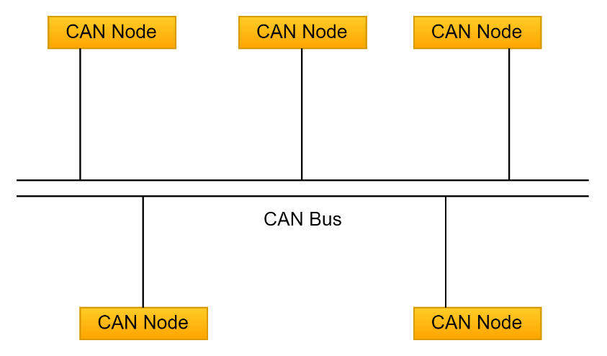
Controller Area Network (CAN bus)
Development of the CAN bus started in 1983.
The protocol was officially released in 1986.
The first CAN controller chips were introduced by Intel in 1987.
Bosch Released CAN2.0 Protocol Standard in 1991.
In 1993, the International Organization for Standardization (ISO) released CAN standard ISO 11898
ISO 11898-1 : Covers the Data link layer
ISO 11898-2 : Covers the CAN physical layer for high-speed CAN ( 1 Mb/s → 5 Mb/s )
ISO 11898-3 : Covers the CAN physical layer for high-speed CAN ( 125 Kb/s )
Bosch released CAN Flexible Data-Rate (CAN FD) 1.0 in 2012.

Slide 7
Controller Area Network (CAN bus)
Serial Protocol.
Asynchronous Protocol.
Multi-Master Protocol.
Broadcasting Protocol.
Flexibility (Easy Connection Adding/Removal.)
Built-in Error Detection and Error Handling Mechanisms.
Message-Based Protocol
Periodical Messages ( 50ms – 1s)
Message-Triggering (Event Based).

Slide 8
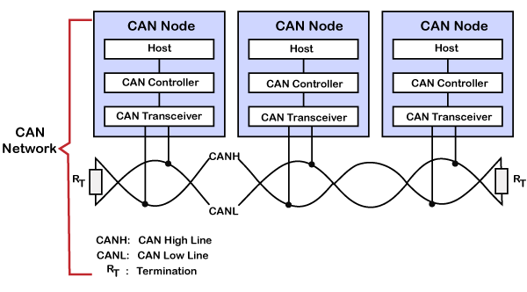
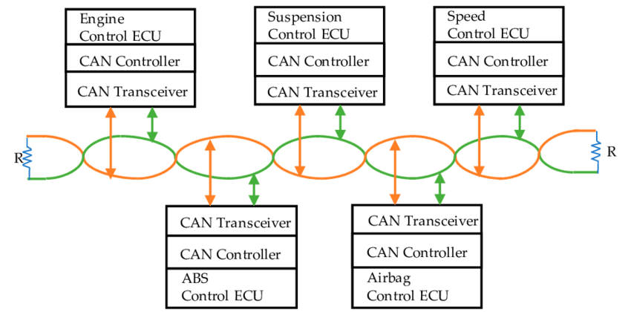
Controller Area Network (CAN bus)
Data speed starts from 20Kb/s to 1Mb/s at High Speed CAN.
CAN FD can provide a 5Mb/s speed.
Low Cost compared to Ethernet.
Large Number Of nodes can be added.
Twisted Pair lines for Data (CANH & CANL).
Most commonly protocol used in Automotive Applications.
Open-Source Availability .

Slide 9
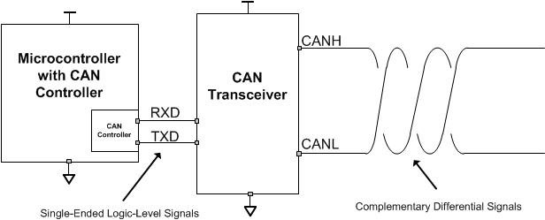
Controller Area Network (CAN bus)
CAN Controller Provides you TXD & RXD as normal Comm protocols we use a CAN Transceiver to get CANH & CANL to get a differential pair

Slide 10
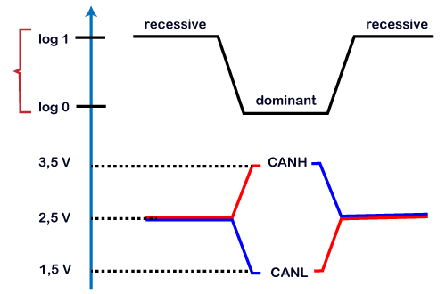
Controller Area Network (CAN bus)
If (CAN Diff < 0.5 V) the bus is considered to be in a Recessive State.
If (CAN Diff > 0.9 V) the bus is considered to be in a Dominant State.
If (0.5 V < CAN Diff < 0.9 V) the bus is considered to be in an Undefined State.
 | TTL | CAN Differential
Recessive State | Logic 1 | CANH = 2.5 V CANL = 2.5 V CAN Diff = 0 V
Dominant State | Logic 0 | CANH = 3.5 V CANL = 1.5 V CAN Diff = 2 V

Slide 11
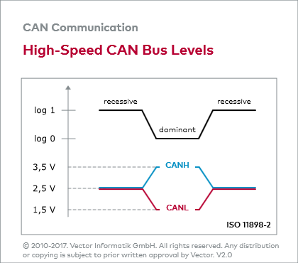
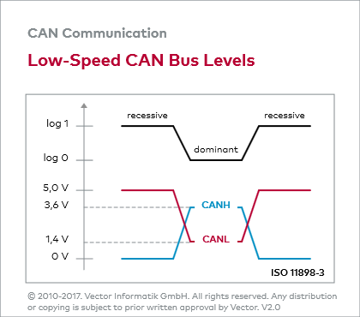

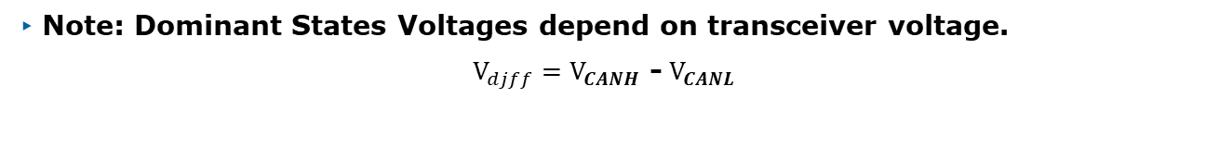
Controller Area Network (CAN bus)
High-Speed CAN Bus Levels Low-Speed CAN Bus Levels
Note: Dominant States Voltages depend on transceiver voltage.
$V_{djff}=V_{CANH}$ -${ V}_{CANL}$

Slide 12
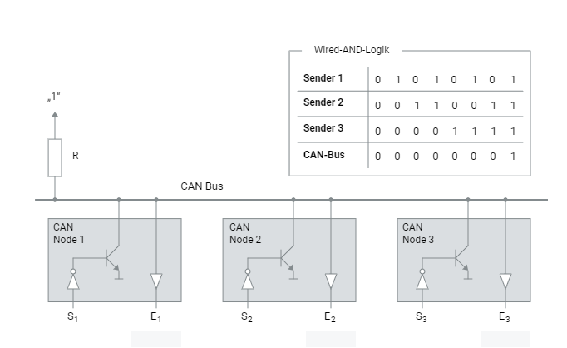
Controller Area Network (CAN bus)
All CAN nodes are wired logical AND connection

Slide 13
Controller Area Network (CAN bus)
Standard CAN (CAN2.0A) vs Extended CAN (CAN 2.0B)
CAN protocol is message based protocol.
Each Message has a unique Identifier.
Standard CAN is the most used bus. (Less overhead – Good throughput – Latancy improved.
Extended CAN is 11-bit base id + 18-bit extended id.
Both Standard & Extended data frames can be used on the same CAN bus.
 | Standard CAN | Extended CAN
Identifier bits | 11-bit | 29-bit
No. of Identifiers/Messages | 2048 Identifiers | 536,870,912 Identifiers

Slide 14
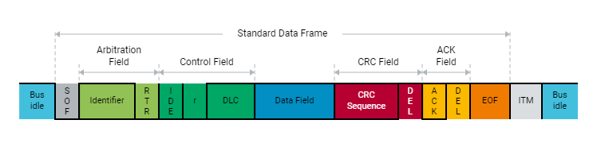
Controller Area Network (CAN bus)

Slide 15
Controller Area Network (CAN bus)
IDLE STATE:
Idle State is detected by a sequence of 11 recessive bits.
SOF:
Transmission of a data frame begins with the start bit (Start of Frame — SOF). It is transmitted by the sender as a dominant level which produces a signal edge from the previous recessive (bus idle) level which is used to synchronize the entire network. In order for the receivers not to lose synchronism to the sender during transmission of the frame, they compare all recessive-to-dominant signal edges with their preset bit timing. In case of deviation, receivers re-synchronize by the amount of the relevant phase error (re-synchronization)
ID:
Following the SOF is the identifier (ID). This sets the priority of the data frame, and together with the acceptance filtering it provides for sender-receiver relations in the CAN network that are defined in the communication matrix.
RTR:
Next comes the RTR bit (Remote Transmission Request). It is used by the sender to inform receivers of the frame type (data frame or remote frame). A dominant RTR bit indicates a data frame.

Slide 16
Controller Area Network (CAN bus)
IDE:
The IDE bit (Identifier Extension bit) which follows serves to distinguish between standard format and extended format. In standard format the identifier has 11 bits, and in extended format 29 bits.
DLC:
The DLC (Data Length Code) communicates the number of payload bytes to the receivers. The payload bytes are transported in the data field. A maximum of eight bytes can be transported in one data frame.
CRC:
The payload is protected by a checksum using a cyclic redundancy check (CRC) which is ended by a delimiter bit. Based on the results of the CRC.
ACK:
the receivers acknowledge positively or negatively in the ACK slot (acknowledgement) which also is followed by a delimiter bit.
EOF:
After this the transmission of a data frame is terminated by seven recessive bits (End Of Frame — EOF).

Slide 17
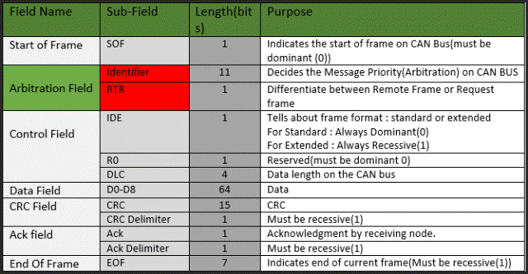
Controller Area Network (CAN bus)

Slide 18
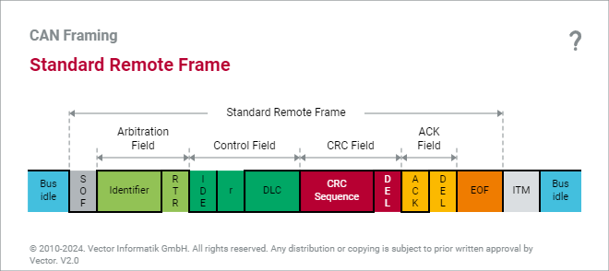
Controller Area Network (CAN bus)

Slide 19
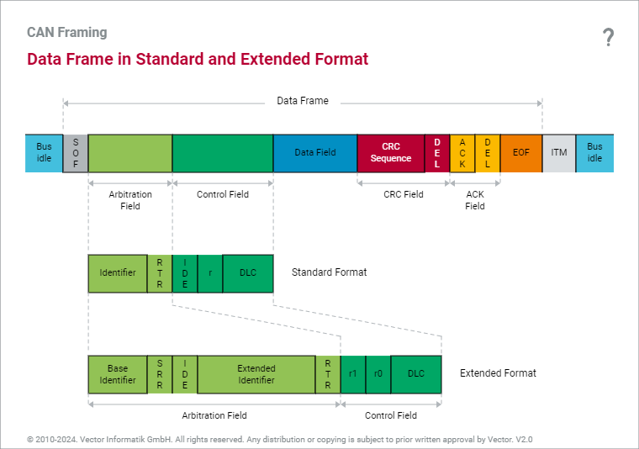
Controller Area Network (CAN bus)

Slide 20
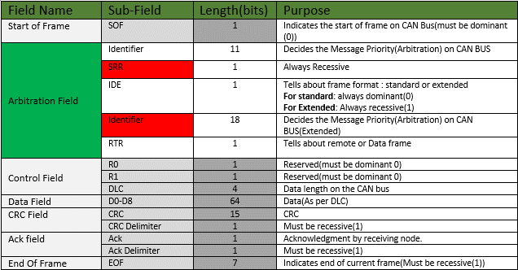
Controller Area Network (CAN bus)

Slide 21
Controller Area Network (CAN bus)
IDE bit | IDE = 0 Dominant | IDE = 1 Recessive
Frame Type | Standard Frame 11-bit | Extended Frame 29-bit
RTR bit | RTR = 0 Dominant | RTR = 1 Recessive
Frame Type | Data Frame | Remote Frame

Slide 22
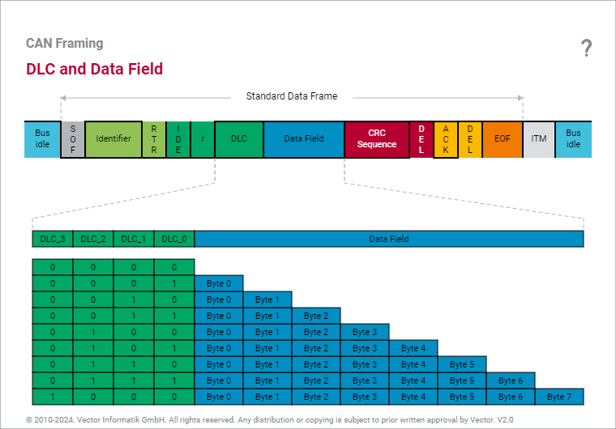
Controller Area Network (CAN bus)

Slide 23
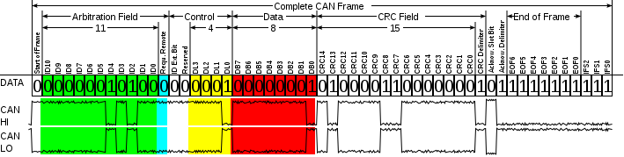
Controller Area Network (CAN bus)
the ACK bit is sent “Recessive 1” by the sender node.
If the ACK is cleared by the receiver then it’s successfully sent and received by nodes.
If the ACK is not cleared by the receiver the sender sends an error frame that no node has successfully received the frame.

Slide 24
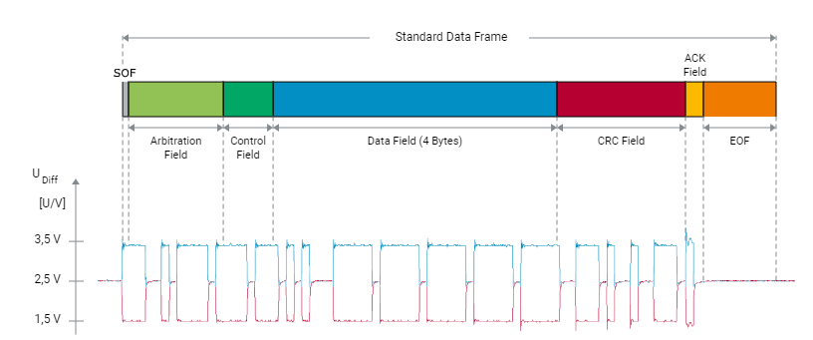
Controller Area Network (CAN bus)

Slide 25
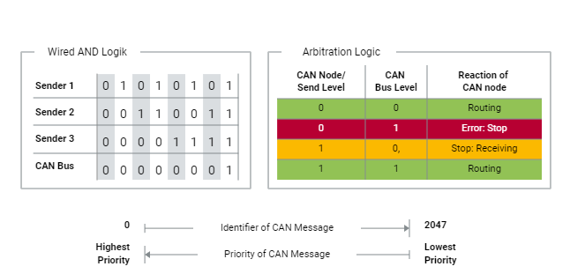
Controller Area Network (CAN bus)

Slide 26
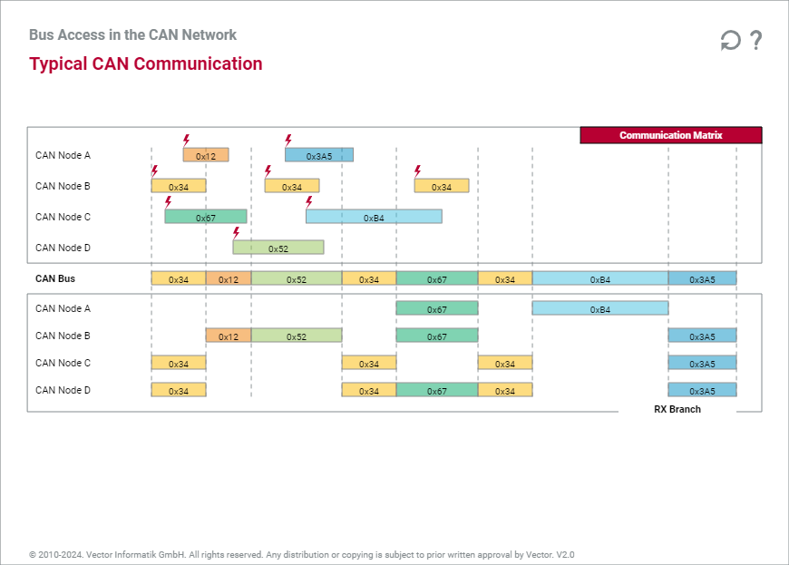
Controller Area Network (CAN bus)

Slide 27
Controller Area Network (CAN bus)

Slide 28
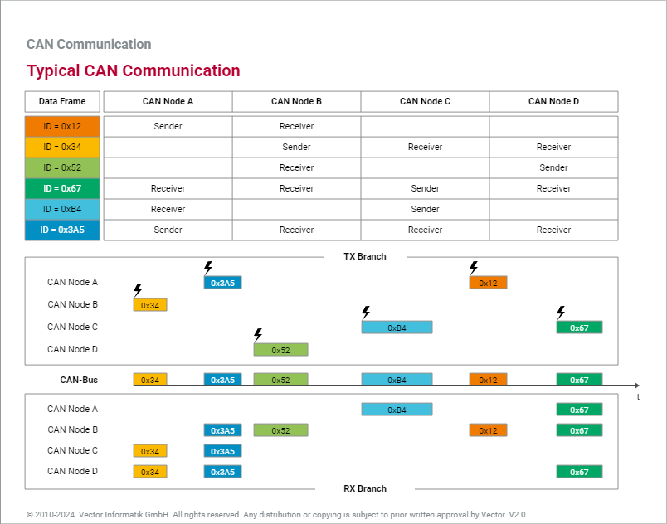
Controller Area Network (CAN bus)

Slide 29
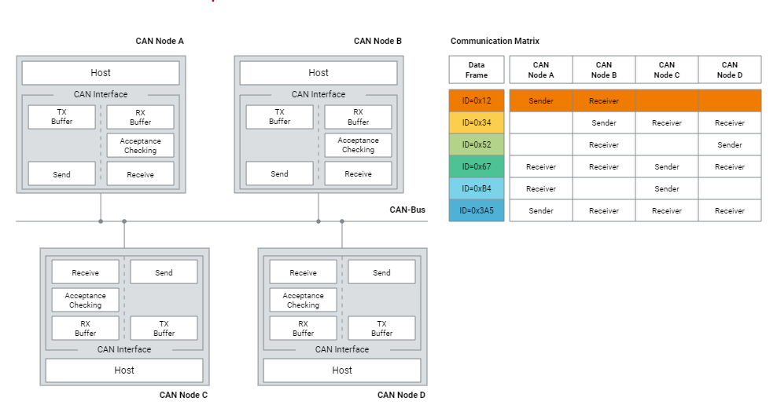
Controller Area Network (CAN bus)

Slide 30
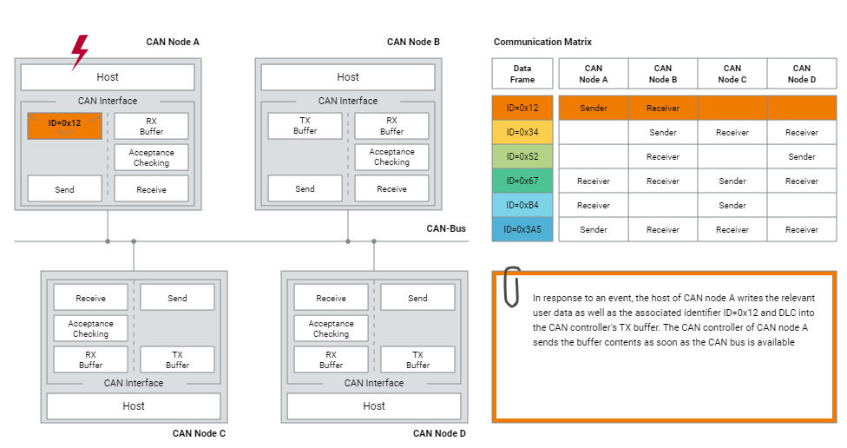
Controller Area Network (CAN bus)

Slide 31
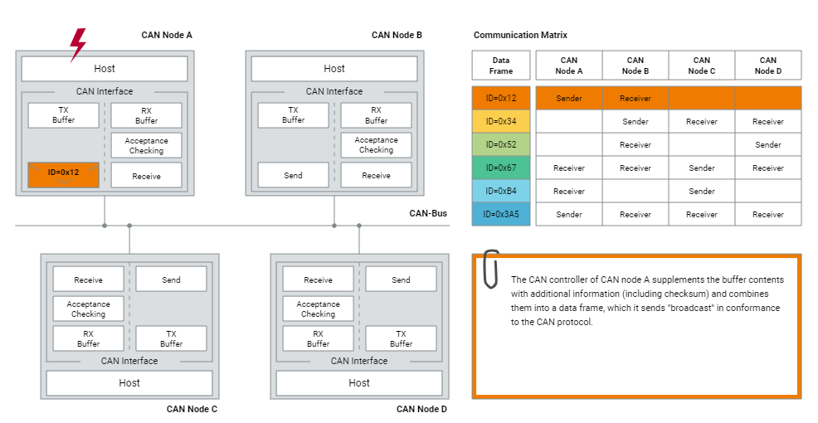
Controller Area Network (CAN bus)

Slide 32
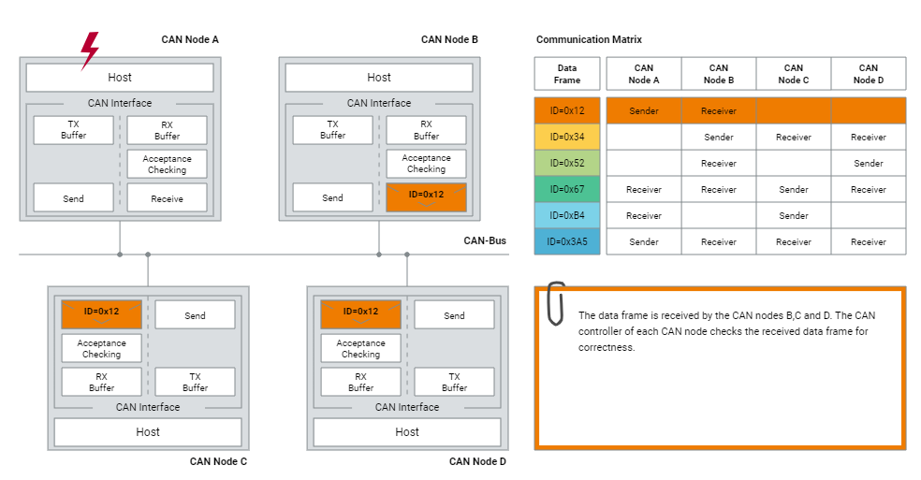
Controller Area Network (CAN bus)

Slide 33
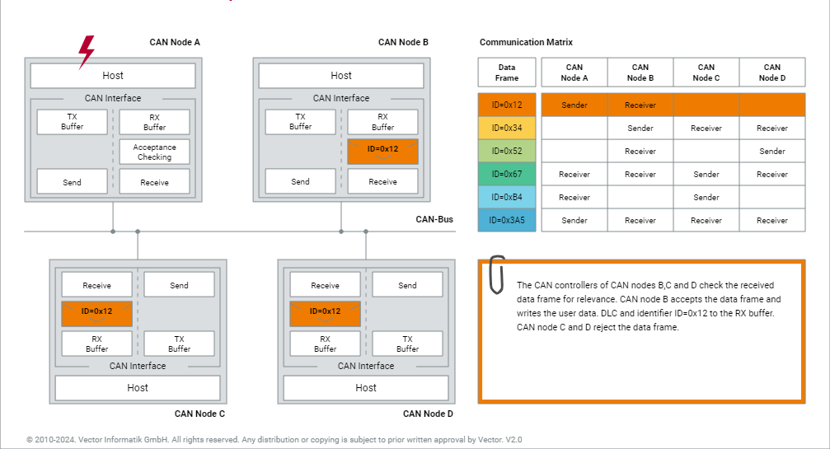
Controller Area Network (CAN bus)

Slide 34
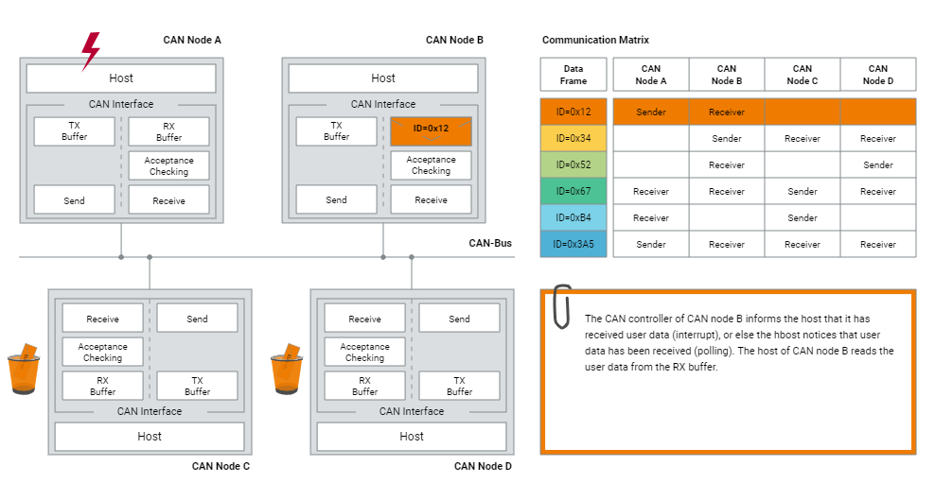
Controller Area Network (CAN bus)

Slide 35
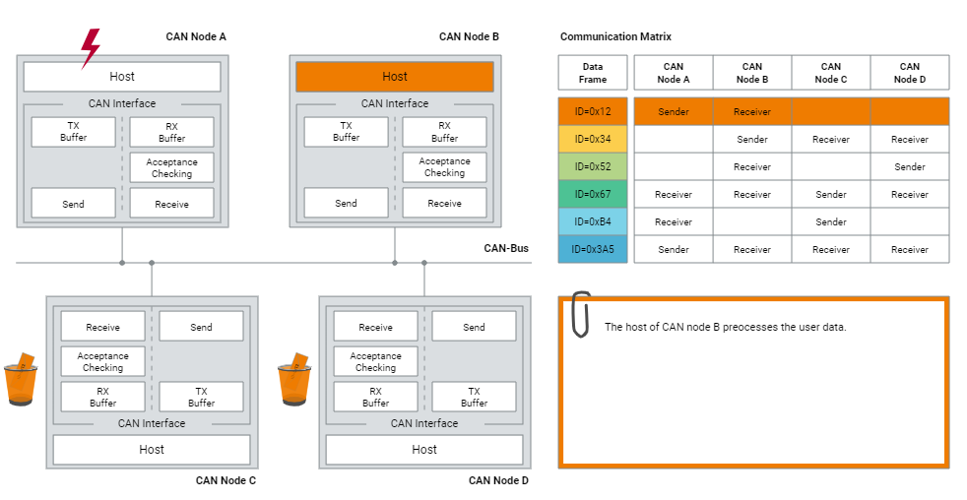
Controller Area Network (CAN bus)

Slide 36
Controller Area Network (CAN bus)
Remote Frame is used to request data, requesting data frames from any CAN nodes.
Remote Frames can be transmitted as Standard or Extended Frames.
Controlled by RTR bit
RTR bit | RTR = 0 Dominant | RTR = 1 Recessive
Frame Type | Data Frame | Remote Frame

Slide 37
Controller Area Network (CAN bus)
RTR = 1, IDE = 1?

Slide 38
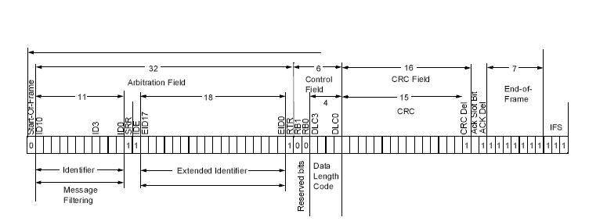
Controller Area Network (CAN bus)
RTR = 1, IDE = 1?

Slide 39
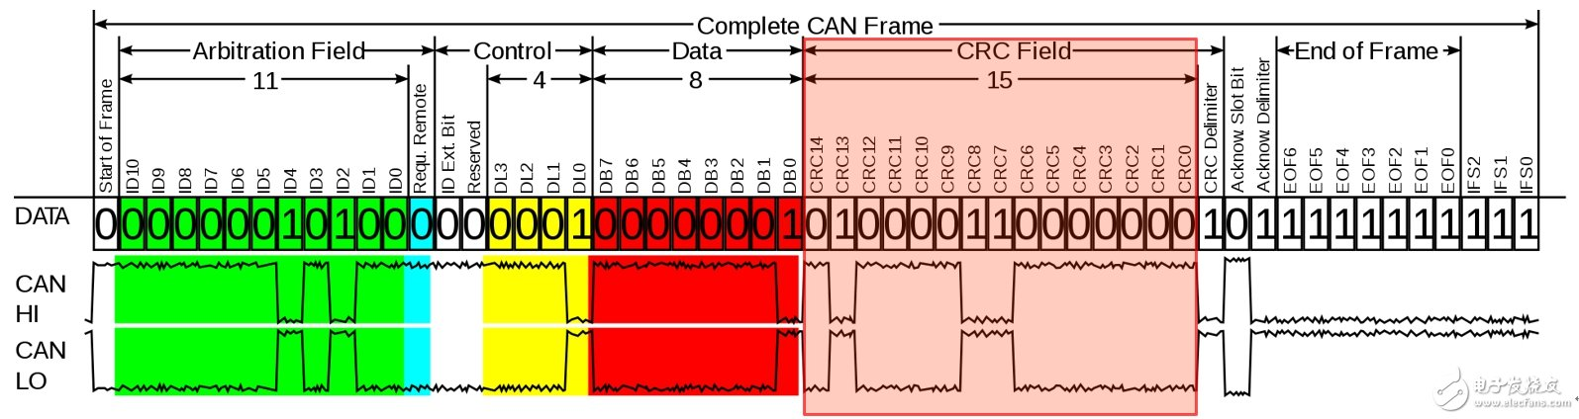
Controller Area Network (CAN bus)
CRC Calculation

Slide 40
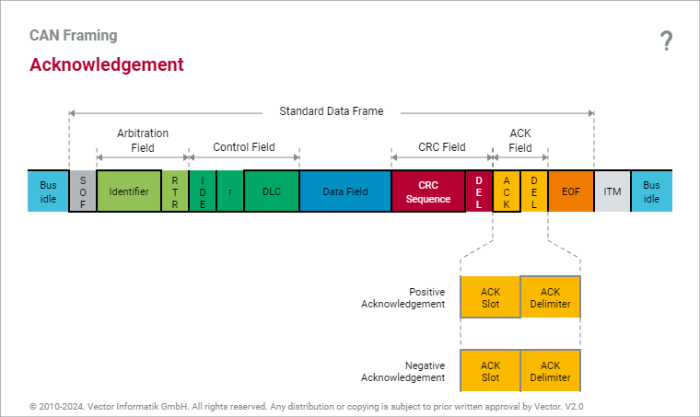
Controller Area Network (CAN bus)
Acknowledgement
Based on the result of this division, each receiver steers the acknowledgement, independent of any acceptance filtering.
A receiver acknowledges either positively or negatively.
A dominant level in the ACK slot represents a positive acknowledgement, while a recessive level represents a negative acknowledgement.

Slide 41
Controller Area Network (CAN bus)
Acknowledgement Delimiter
The ACK delimiter is always transmitted recessively for the purpose of error tracking.
Since the sender transmits both the ACK slot and the ACK delimiter recessively, one positive acknowledgement is sufficient to confirm the correctness of the message transmission to the sender.
That is why the acknowledgement method in the CAN network is referred to as a node-neutral positive acknowledgement.

Slide 42
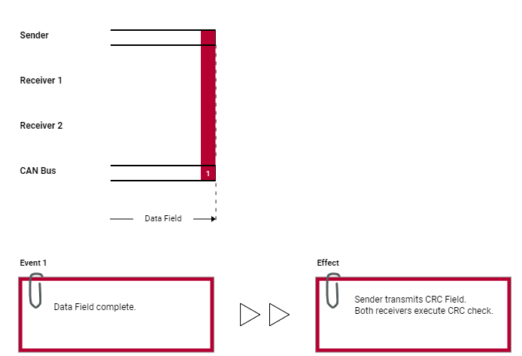
Controller Area Network (CAN bus)
Positive Acknowledgement

Slide 43
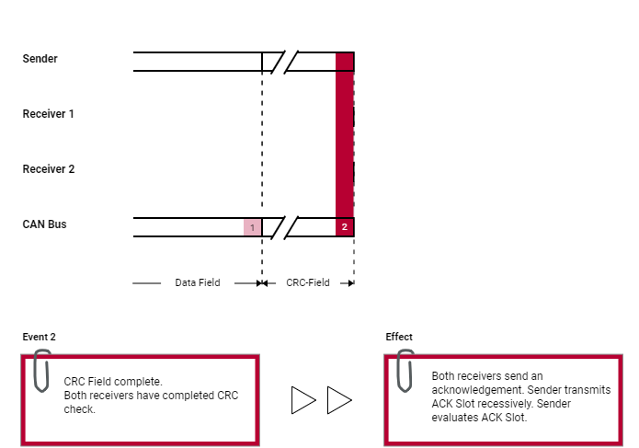
Controller Area Network (CAN bus)
Positive Acknowledgement

Slide 44
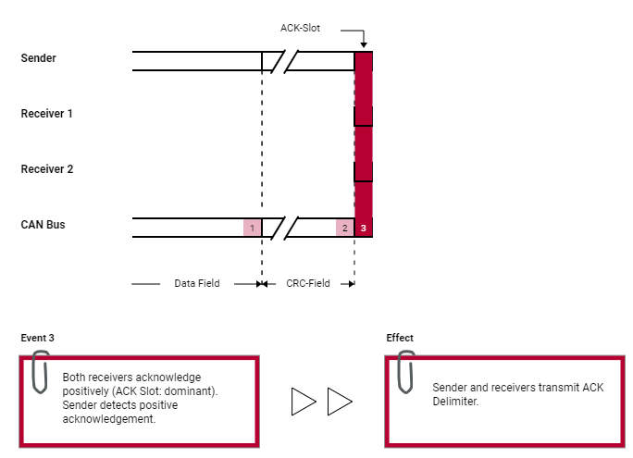
Controller Area Network (CAN bus)
Positive Acknowledgement

Slide 45
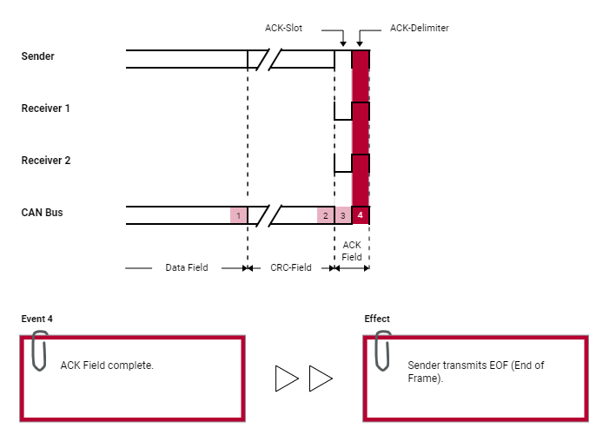
Controller Area Network (CAN bus)
Positive Acknowledgement

Slide 46
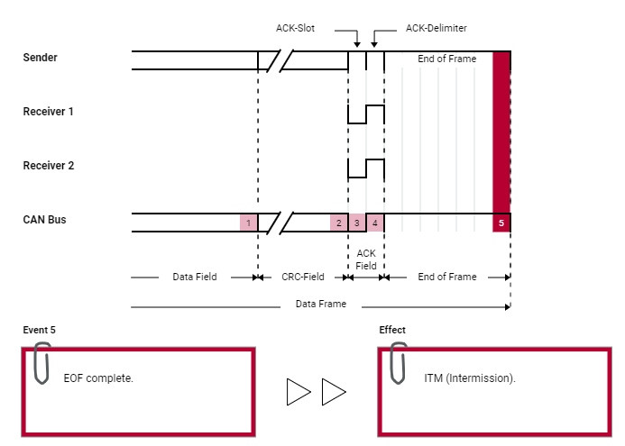
Controller Area Network (CAN bus)
Positive Acknowledgement

Slide 47
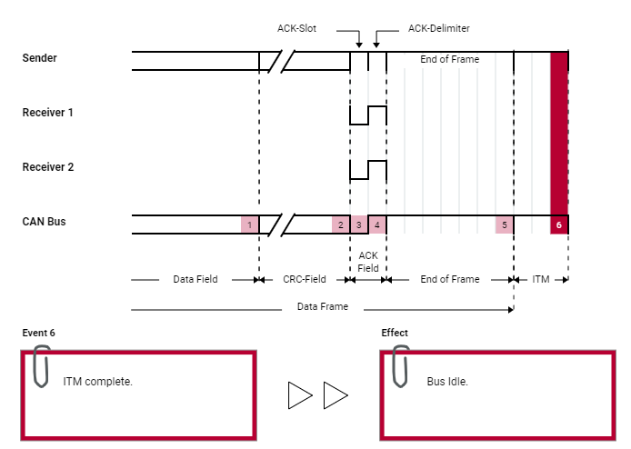
Controller Area Network (CAN bus)
Positive Acknowledgement

Slide 48
Controller Area Network (CAN bus)
Logical Error Detection
Five Mechanisms to detect an error
Bit Monitoring (Performed by the Sender)
Stuff Check (Performed by the Receiver)
Form (Format) Check (Performed by the Receiver)
Cyclic Redundancy Check (CRC) (Performed by the Receiver)
ACK Check (Performed by the Sender)

Slide 49
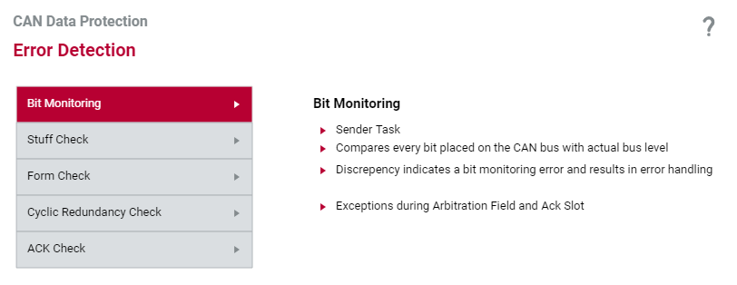
Controller Area Network (CAN bus)
Logical Error Detection
Five Mechanisms to detect an error
Bit Monitoring (Performed by the Sender)
Within the framework of bit monitoring, the sender compares the sent bit level with the actual bus level. A bit error exists if the sender detects a discrepancy between the two levels. Bit monitoring ensures that all global errors and all local errors occurring at the sender are detected.

Slide 50
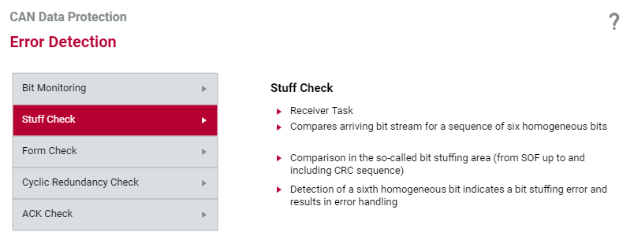
Controller Area Network (CAN bus)
Logical Error Detection
Five Mechanisms to detect an error
Stuff Check (Performed by the Receiver)
The stuff check serves to check the bit stream. The CAN protocol specifies that the sender must transmit a complementary bit after five homogeneous bits — for synchronization purposes. There is a stuffing error if more than five homogeneous contiguous bits are received.

Slide 51
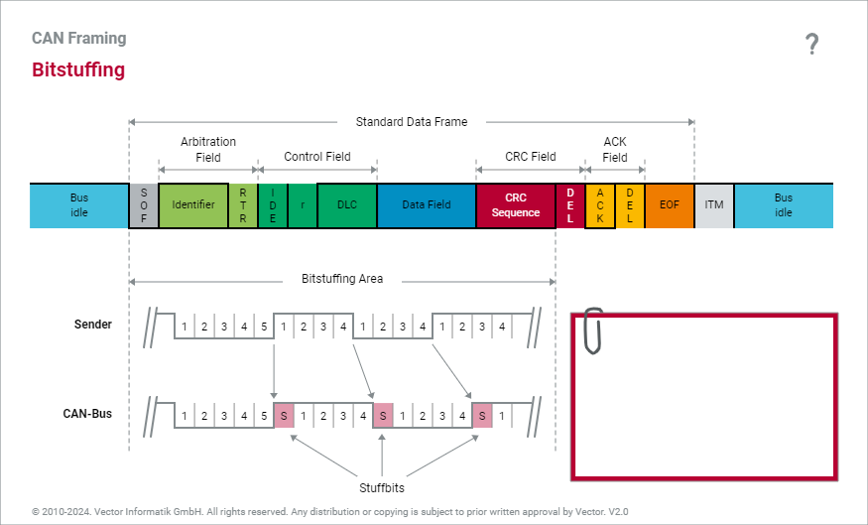
Controller Area Network (CAN bus)
Bit Stuffing

Slide 52
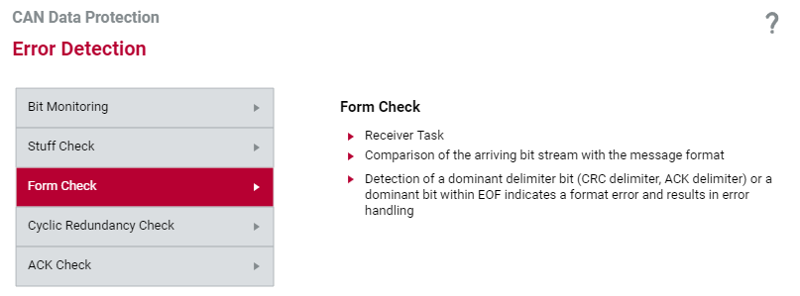
Controller Area Network (CAN bus)
Logical Error Detection
Five Mechanisms to detect an error
Form (Format) Check (Performed by the Receiver)
The form check serves to check the format of a CAN message. Each CAN message always exhibits the same bit sequences at certain positions. They are the CRC delimiter, ACK delimiter and EOF. Senders always transmit these message components recessively. A format error exists if a receiver detects a dominant bus level within one of these message components in the Form Check.

Slide 53
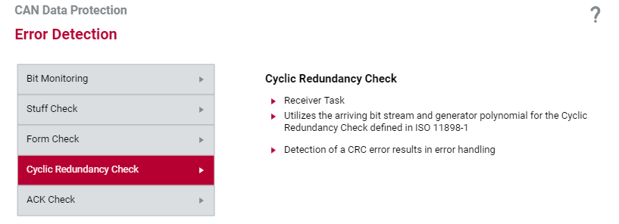
Controller Area Network (CAN bus)
Logical Error Detection
Five Mechanisms to detect an error
Cyclic Redundancy Check (CRC) (Performed by the Receiver)
In the cyclic redundancy check (CRC) the polynomial R(x) associated with the arriving data or remote frame should equal a multiple of the generator polynomial G(x) specified by ISO 11898-1. If this is not the case (CRC error), then the data or remote frame was corrupted during its transmission.

Slide 54
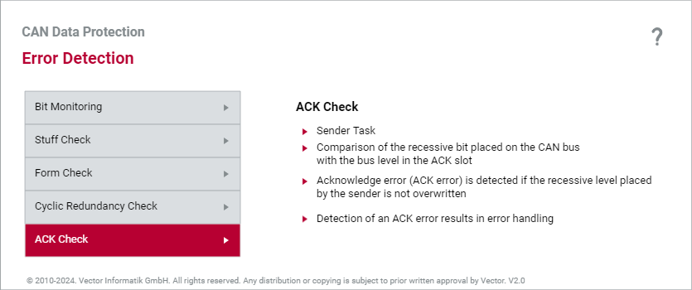
Controller Area Network (CAN bus)
Logical Error Detection
Five Mechanisms to detect an error
ACK Check (Performed by the Sender)
The acknowledgement mechanism defined in the CAN protocol specifies that all receivers must acknowledge every arriving CAN message right after the cyclic redundancy check. A single positive acknowledgement is sufficient to signal to the sender that at least one receiver received the CAN message it transmitted correctly. If not a single positive acknowledgement arrives at the sender, then an acknowledgement error has occurred (ACK error).

Slide 55
Thank you ☺

